Slide 1
Seminario de Lenguajes (opción PHP/React/API REST) – JS
JavaScript (ES6)
  Clases
    Constructor
    Instanciación
    Métodos
    Herencia
    super() y this
class Car {
constructor(name) {
this.brand = name;
}
present() {
return 'I have a ' + this.brand;
}
}
class Model extends Car {
constructor(name, mod) {
super(name);
this.model = mod;
}
show() {
return this.present() + ', it is a ' + this.model
}
}
const mycar = new Model("Ford", "Mustang");
mycar.show();
Fac. de Informática - Raúl Champredonde <number>

Slide 2
Seminario de Lenguajes (opción PHP/React/API REST) – JS
JavaScript (ES6)
  Arrow functions
function hello(val) {
return "Hello " + val;
}
hello = function(val) {
return "Hello " + val;
}
hello = (val) => {
return "Hello " + val;
}
hello = (val) => "Hello " + val;
hello = val => "Hello " + val;
str = hello("World");
Fac. de Informática - Raúl Champredonde <number>

Slide 3
Seminario de Lenguajes (opción PHP/React/API REST) – JS
JavaScript (ES6)
  Arrow functions
    this
<button id="btn">Click Me!</button>
<p id="demo"></p>
<script>
class Header {
constructor() {
this.color = "Red";
}
changeColor = function() {
document.getElementById("demo").innerHTML += this;
}
}
const header = new Header();
window.addEventListener("load", header.changeColor);
// [object Window]
document.getElementById("btn")
.addEventListener("click", header.changeColor);
// [object HTMLButtonElement]
</script>
Fac. de Informática - Raúl Champredonde <number>

Slide 4
Seminario de Lenguajes (opción PHP/React/API REST) – JS
JavaScript (ES6)
  Arrow functions
    this
<button id="btn">Click Me!</button>
<p id="demo"></p>
<script>
class Header {
constructor() {
this.color = "Red";
}
changeColor = () => {
document.getElementById("demo").innerHTML += this;
}
}
const header = new Header();
window.addEventListener("load", header.changeColor);
// [object Object]
document.getElementById("btn")
.addEventListener("click", header.changeColor);
// [object Object]
</script>
Fac. de Informática - Raúl Champredonde <number>

Slide 5
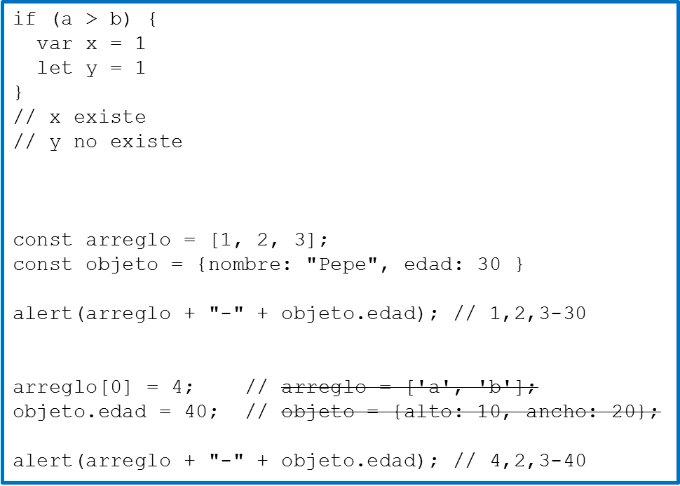
Seminario de Lenguajes (opción PHP/React/API REST) – JS
JavaScript (ES6)
  var
    global
    local
    bloques
  let
    global
    local
    bloques
  const
    aaa
Fac. de Informática - Raúl Champredonde <number>

Slide 6
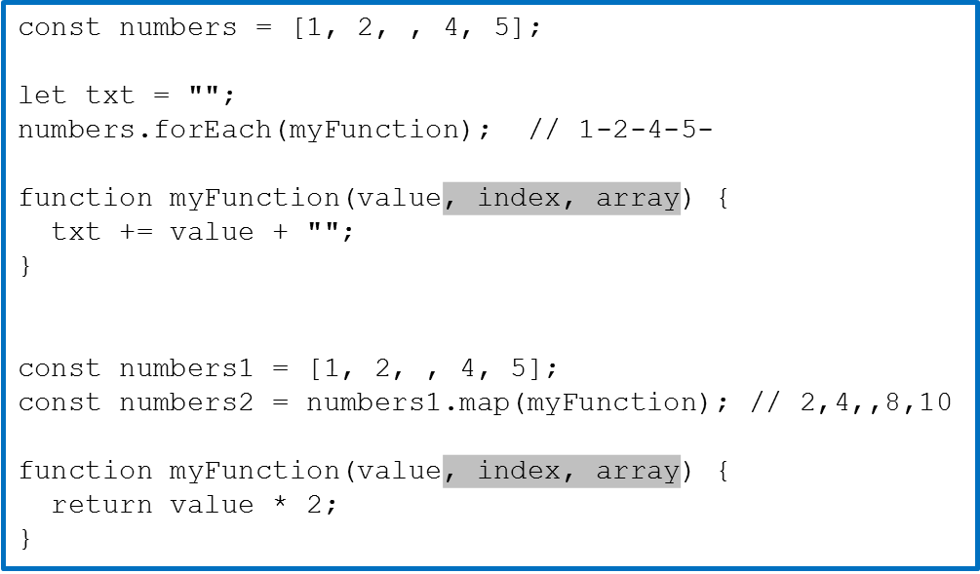
Seminario de Lenguajes (opción PHP/React/API REST) – JS
JavaScript (ES6)
  Array methods
    forEach
    map
    length
    toString
    pop
    push
    shift
    unshift
    join
    delete
    concat
    …
(value)
(value)
Fac. de Informática - Raúl Champredonde <number>

Slide 7
Seminario de Lenguajes (opción PHP/React/API REST) – JS
JavaScript (ES6)
  Destructuring
    Arrays
const vehicles = ['mustang', 'f-150', 'expedition'];
const car = vehicles[0]; const truck = vehicles[1]; const suv = vehicles[2]; | const [car, truck, suv] = vehicles; let [vcar, vtruck, vsuv] = vehicles; const [car,, suv] = vehicles; let [vcar,, vsuv] = vehicles;
function calculate(a, b) { return [a + b, a - b, a * b, a / b]; } const [add, subtract, multiply, divide] = calculate(8, 4); // 12,4,32,2
function func([w, x, y, z]) { const str = w + "-" + x + "-" + y + "-" + z document.write("<p>" + str + "</p>"); } |  | const numbers = [1, 2, 3, 4]; func(numbers); // 1-2-3-4 func([5, 6, 7, 8]); // 5-6-7-8 func(calculate(8, 4)); // 12-4-32-2
Fac. de Informática - Raúl Champredonde <number>

Slide 8
Seminario de Lenguajes (opción PHP/React/API REST) – JS
JavaScript (ES6)
  Destructuring
    Objects
const person = { name: 'Pep', age: 30 } | func(person); function func({name, age}) { const message = 'Name ' + name + ' age ' + age + '.'; document.getElementById("demo").innerHTML = message; }
const person = { name: 'Pep', country: 'Fiyi', birthdate: { day: 13, month: 4, year: 2010 } } | func(person); function func({name, birthdate: {year}}) { const message = 'Name ' + name + ' year ' + year + '.'; document.getElementById("demo").innerHTML = message; }
Fac. de Informática - Raúl Champredonde <number>

Slide 9
Seminario de Lenguajes (opción PHP/React/API REST) – JS
JavaScript (ES6)
  Spread operator
    Arrays
const numbersOne = [1, 2, 3]; const numbersTwo = [4, 5, 6]; const numbersCombined = [...numbersOne, ...numbersTwo];
const numbers = [1, 2, 3, 4, 5, 6]; const [one, two, ...rest] = numbers; function func([x, y, ...z]) { document.write("<p>" + z + "</p>"); } func(numbers);
Fac. de Informática - Raúl Champredonde <number>

Slide 10
Seminario de Lenguajes (opción PHP/React/API REST) – JS
JavaScript (ES6)
  Spread operator
    Objects
const myVehicle = { brand: 'Ford', model: 'Mustang', color: 'red' } const updateMyVehicle = { type: 'car', year: 2021, color: 'yellow' } const myUpdatedVehicle = {...myVehicle, ...updateMyVehicle} // { brand: "Ford", model: "Mustang", color: "yellow", type: "car", year: 2021 }
func(myUpdatedVehicle); function func({model, color, ...others}) { console.log(others); // { brand: "Ford", type: "car", year: 2021 } }
Fac. de Informática - Raúl Champredonde <number>

Slide 11
Seminario de Lenguajes (opción PHP/React/API REST) – JS
JavaScript (ES6)
  Modules
person.js ========= export const name = "Jesse" export const age = 40 | person.js ========= const name = "Jesse" const age = 40 export { name, age } | message.js ========== const message = () => { const name = "Jesse"; const age = 40; return name + ' ' + age; }; export default message;
xxx.js ====== import { name, age } from "./person.js"; import message from "./message.js";
Fac. de Informática - Raúl Champredonde <number>

Slide 12
Seminario de Lenguajes (opción PHP/React/API REST) – JS
JavaScript (ES6)
  Modules
person.js ========= export const name = "Jesse" export const age = 40 | person.js ========= const name = "Jesse" const age = 40 export { name, age } | message.js ========== const message = () => { const name = "Jesse"; const age = 40; return name + ' ' + age; }; export default message;
xxx.js ====== import { name, age } from "./person.js"; import message from "./message.js";
Fac. de Informática - Raúl Champredonde <number>

Slide 13
Seminario de Lenguajes (opción PHP/React/API REST) – React
React
  Librería javascript que permite crear componentes de UI
  Crea un DOM virtual en el que realiza todo lo necesario para luego hacer sólo las modificaciones necesarias en el DOM del browser
  JSX
    JavaScript + HTML
Fac. de Informática - Raúl Champredonde <number>

Slide 14
Seminario de Lenguajes (opción PHP/React/API REST) – React
React
import React from 'react';
import ReactDOM from 'react-dom/client';
import App from './App';
const htmlRoot = document.getElementById('root');
const root = ReactDOM.createRoot(htmlRoot);
root.render(<App />);
index.js
<!DOCTYPE html>
<html lang="en">
...
<body>
<div id="root"></div>
</body>
</html>
index.html
import './App.css';
function App() {
return (
<div className="App">
...
</div>
);
}
export default App;
App.js
Tener instalado Node.js (nodejs.org)
> npx create-react-app my-react-app
> npm start
Fac. de Informática - Raúl Champredonde <number>

Slide 15
Seminario de Lenguajes (opción PHP/React/API REST) – React
React
  Components
    Funciones que devuelven markup
    Se pueden anidar
    Sus nombres deben comenzar con mayúscula
function MyButton() {
return (
<button>I'm a button</button>
);
}
import './App.css';
function App() {
return (
<div>
<h1>Welcome to my app</h1>
<MyButton />
</div>
);
}
export default App;
Fac. de Informática - Raúl Champredonde <number>

Slide 16
Seminario de Lenguajes (opción PHP/React/API REST) – React
React
  JSX
    Tags cerrados con "/" (<div> </div> <br /> <MyButton />)
    No puede retornar varios tags
return (
<div>
<h1>Welcome to my app</h1>
<MyButton />
</div>
);
return (
<>
<h1>Welcome to my app</h1>
<MyButton />
</>
);
Fac. de Informática - Raúl Champredonde <number>

Slide 17
Seminario de Lenguajes (opción PHP/React/API REST) – React
React
  Styles
  Datos
const user = {
name: 'Hedy Lamarr',
imageUrl: 'https://i.imgur.com/yXOvdOSs.jpg',
imageSize: 90,
};
function Profile() {
return (
<>
<h1>{user.name}</h1>
<img
className="avatar"
src={user.imageUrl} alt={'Photo of ' + user.name}
style={{
width: user.imageSize,
height: user.imageSize
}}
/>
</>
);
}
<img
class="avatar"
src=https://i.imgur.com/yXOvdOSs.jpg
alt="Photo of Hedy Lamarr"
style="width: 90px; height: 90px;"
>
Fac. de Informática - Raúl Champredonde <number>

Slide 18
Seminario de Lenguajes (opción PHP/React/API REST) – React
React
  Conditional rendering
function Profile() {
let content;
if (user.name) {
content = <h1>{user.name}</h1>;
} else {
content = <img
className="avatar"
src={user.imageUrl} alt={'Photo of ' + user.name}
style={{
width: user.imageSize,
height: user.imageSize
}}
/>;
}
return (
<div>
{content}
</div>
);
}
<div>
{user.name ? (
<h1>{user.name}</h1>
) : (
<img
className="avatar"
src={user.imageUrl} alt={...}
style={{ ... }}
/>
)}
</div>
Fac. de Informática - Raúl Champredonde <number>

Slide 19
Seminario de Lenguajes (opción PHP/React/API REST) – React
React
  Rendering lists
const products = [
{ title: 'Cabbage', isFruit: false, id: 1 },
{ title: 'Garlic', isFruit: false, id: 2 },
{ title: 'Apple', isFruit: true, id: 3 },
];
function ShoppingList() {
const listItems = products.map(product =>
<li
key={product.id}
style={{ color: product.isFruit ? 'magenta' : 'darkgreen' }}
>
{product.title}
</li>
);
return (
<ul>{listItems}</ul>
);
}
Fac. de Informática - Raúl Champredonde <number>

Slide 20
Seminario de Lenguajes (opción PHP/React/API REST) – React
React
  Eventos
function MyButton() {
function handleClick() {
alert('You clicked me!');
}
return (
<button onClick={handleClick}>
Click me
</button>
);
}
Fac. de Informática - Raúl Champredonde <number>

Slide 21
Seminario de Lenguajes (opción PHP/React/API REST) – React
React
  Component state / hooks
import { useState } from 'react';
function MyButton() {
const [count, setCount] = useState(0);
function handleClick() {
setCount(count + 1);
}
return (
<button onClick={handleClick}>
Clicked {count} times
</button>
);
}
function App() {
return (
<div>
<MyButton />
<MyButton />
</div>
);
}
Fac. de Informática - Raúl Champredonde <number>

Slide 22
Seminario de Lenguajes (opción PHP/React/API REST) – React
React
  Compartir estado y manejador de evento. Props
function App() {
const [count, setCount] = useState(0);
function handleClick() {
setCount(count + 1);
}
return (
<div className="App">
<header className="App-header">
<div>
<MyButton count={count} onClick={handleClick} />
<MyButton count={count} onClick={handleClick} />
</div>
</header>
</div>
);
}
function MyButton(props) {
return (
<button onClick={props.onClick}>
Clicked {props.count} times
</button>
);
}
Fac. de Informática - Raúl Champredonde <number>

Slide 23
Seminario de Lenguajes (opción PHP/React/API REST) – React
React
  Compartir estado y manejador de evento. Props
function App() {
const [count, setCount] = useState(0);
function handleClick() {
setCount(count + 1);
}
return (
<div className="App">
<header className="App-header">
<div>
<MyButton count={count} onClick={handleClick} />
<MyButton count={count} onClick={handleClick} />
</div>
</header>
</div>
);
}
function MyButton({count, onClick}) {
return (
<button onClick={onClick}>
Clicked {count} times
</button>
);
}
Fac. de Informática - Raúl Champredonde <number>

